Slide 1
Data Preparation for Building A Regional Traffic Network Data Hub
ASU Transportation+AI team
Version 1.0
08/20/2022
Version 2.0, 2024

Slide 2
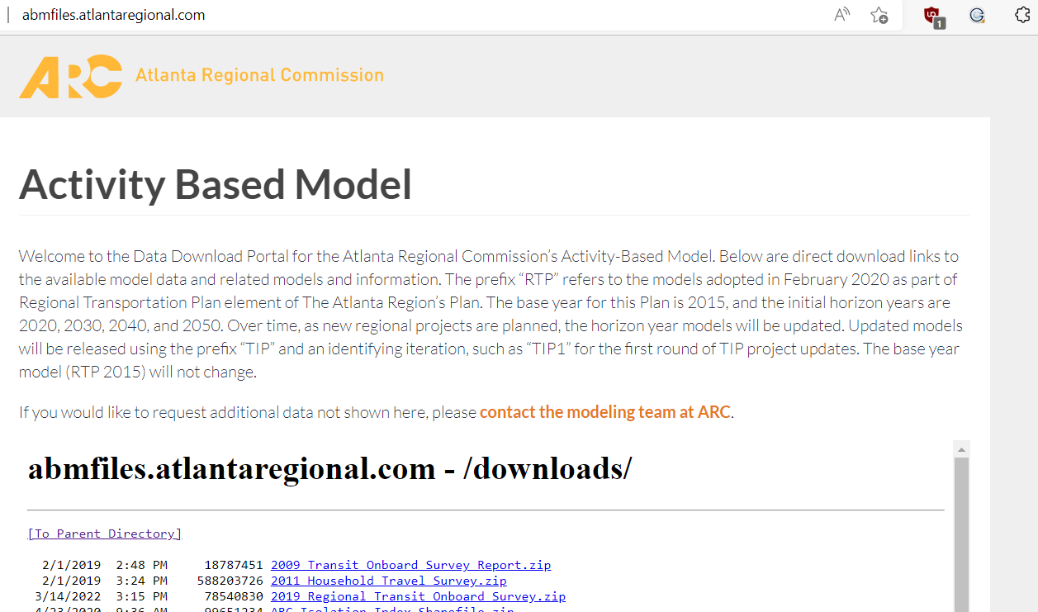
Data Sources: Atlanta Regional Commission’s Activity-Based Model
Download the model and other associated files: http://abmfiles.atlantaregional.com
Download the model shapefile:
https://opendata.atlantaregional.com/datasets/arc-model-transportation-analysis-zones-2020
Review the model documentation:
https://atlregional.github.io/ARC_Model/index.html

Slide 3
List of Essential Data Files and Executables
External input file | GMNS input file | Output of DTALite
1a. Node shape file | 2a. node.csv | 5a. link_performance.csv
1b. Link shape file | 2b. link.csv | 5b. od_accessibility.csv 5c.route_assignment.csv
1c. Zone shape file (optional) | 2c. zone.csv | 5d. Summary.csv
3. Demand file (csv, matrix) | 4. setting.csv demand_file_list and departure time profile | 6a. Agent file 6b. trajectory.csv from simulation
Executable lists
Dtalite.exe
Nexta.exe
Python packages

Slide 4
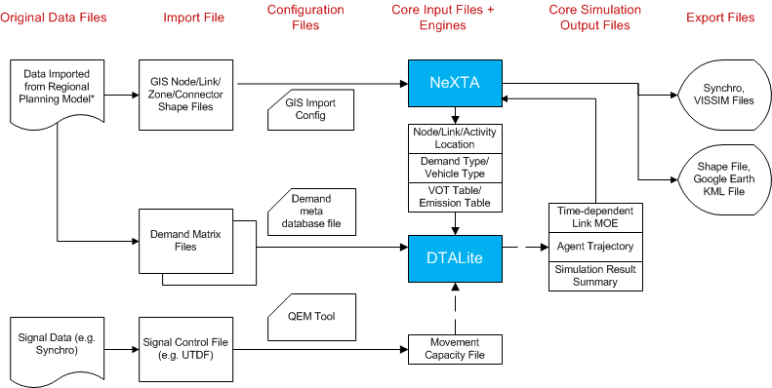
0.Data Flow of Applying Data Hub Implementation in NEXTA
Notes:
This data flow gives the system importing, analysis and exporting data flow for the bundle of DTALite and NEXTA. In particular, our solution to import GIS data from multiple planning packages is to develop an open data format that allows DTALite users to feasibly convert their own data in proprietary format to a unifying data structure and widely used longitude and latitude coordinate system (WGS 84 used by Google Maps, Google Earth and on-line Google Fusion Tables).
In the third step of important data, we use meta data definitions for network and demand files, which can avoid ad-hoc linkages to specific software packages. By integrating a Quick Estimation Method (QEM) as a solid signal control emulator that can provide realistic signal timing and phasing data, we simplify the data preparation process for signalized intersections.
Furthermore, the open-source NEXTA package, as a network editing and visualization tool, is made available through this project to display large-scale dynamic traffic analysis results. It plays a critical role for both validating and reporting operational performance at different bottlenecks.

Slide 5
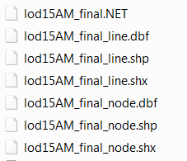
1: Prepare Required Shape files (1a,1b,1c)
Usually, those shape files are from static regional travel model (Cube,
TransCAD, VISSUM, etc.) They are node shape file (1a), link shape file (1b)
and zone shape file (1c).
Zone shape file is optional.
e.g. given shape files for the Atlanta network:
lod15AM_final_node.shp:
provide node ID and coordinate values;
lod15AM_final_line.shp:
provide from node id, to node id, length of links, link type, number of lanes of link, ect.

Slide 6
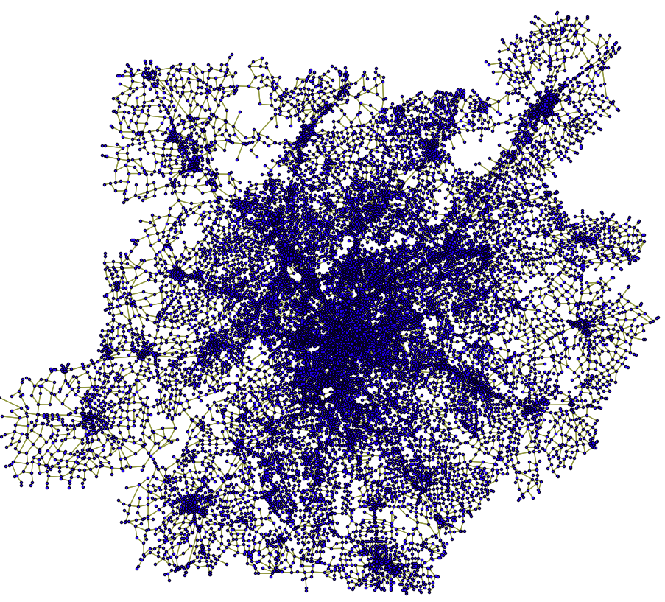
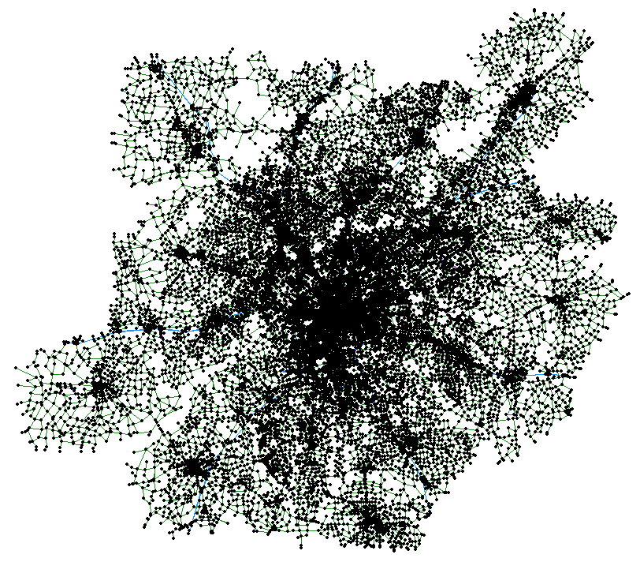
2. Extract GIS information from shape files to GMNS files
GIS Shape files
NeXTA

Slide 7
3. Demand file management
Demand file (4) is the source of dynamic traffic assignment. Generally, it is provided by users. As a data hub, NeXTA can accommodate various demand formats, such as,
column format
matrix format,
agent file,

Slide 8
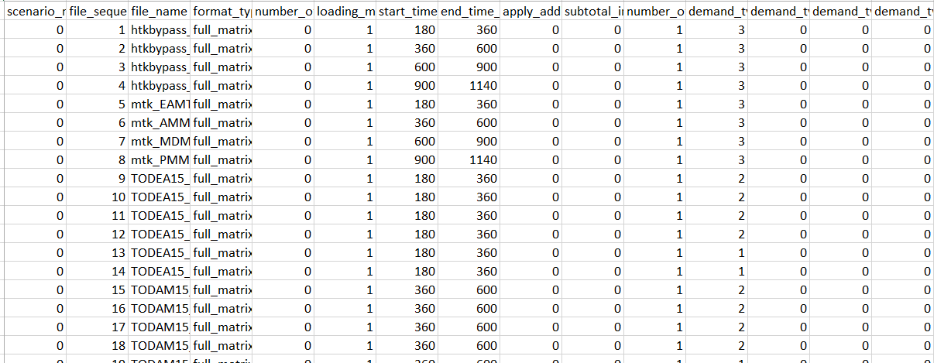
4. Settings.csv
The input_demand_meta_data.csv file (5) is used to define the characteristics of demand data (4). In order to realistically represent the dynamic demand, a temporal demand profile table is designed to initiate trips in the simulation over the modeling horizon.
The details can be found at page 25 of this document https://docs.google.com/document/d/1z4YsztPXcWfQAd8NVD4_KXv7hJcbyXdYPzwL6z8xn3U/edit#

Slide 9
5. Run Path2GMNS model using UE assignment mode
output.
5a. link_performance.csv.
5b. od_accessibility.csv
5c. Route_assignment.csv
We use analytical queueVDF function to produce time-dependent speed, and congestion duration
Visualization in NEXTA

Slide 10
6. Run DTA using simulation mode
Output:
Agent.csv
Trajectory.csv
Visualization in NEXTA

Slide 11
7. CBI
External input sensor file | GMNS input file | Input parameters for DTALite with QVDF
7a. tmc_identification.csv | 7c. link.csv with mapmatched tmc codes, using external mapmatching utility | 7d. cbi_summary.csv
7b. Reading.csv |  | 7e. Cbi_vdf.csv

Slide 12
8. ODME
Input | GMNS input file and settings | Output of ODME
8a. Measurement.csv | Node, link | 8c.link_performance.csv with ODME deviation
8b. initial demand file (prepared in step 3) | Settings.csv with ODME iterations | 8d. Route_assignment contains adjusted OD and path volume

Slide 13
9. Network design and sensitivity analysis
GMNS input file and settings | Output
Node, link SA_lanes | 9c.link_performance.csv with ODME deviation
Settings.csv: sensitivity analysis | 9d. Route_assignment contains adjusted OD and path volume
 | 9c. Corriodor.csv sensitivity

Slide 14
10. workzone and incident scenario evaluation
Scenario section in settings.csv.
Scenario_Link_Based_Toll.csv

Slide 15
11. MRM simulation
External input osm file | Zone 2 access step | Output of DTALite
11a.osm pbf file and osm2gmns package | 11e. TAZ.csv (xy coordinate and boundary | 11g. Link performance.csv
11b. Macro node.csv, link.csv, movement.csv | 11f. Zone.csv with zone_id and access_node.csv | 11h. route_assignment.csv for od based travel time statistics
11c. Meso Node.csv, link.csv
11d. Micro node.csv and link.csv

Slide 16
12. MRM signal timing data management
Input | Update movement across resolutions | Output of DTALite simulation
12a. Signal4gmns python package | 12e. Update macro movement using nexta | 12h. route_assignment.csv for od based travel time statistics
12b. Macro node.csv, link.csv, movement.csv | 12f. Regenerate meso and micro network | 12i. Trajectory.csv
12c. Meso Node.csv, link.csv | 12g. Run signal4gmns python package to generate signal timing coded in Meso and micro link.csv
12d. Micro node.csv and link.csv

Slide 17
13. Subarea cut approach
Please use external packages such as cube or transcad for this step
Input |  | Output of DTALite assignment simulation
13a. Subarea boundary | 13d. Subarea cut Node.csv Link.csv | 13h: link_performance.csv
13b. Macro planning network node.csv, link.csv, movement.csv | 13e. Subarea zone.csv | 13i. route_assignment.csv for subarea od based travel time statistics
13c. OD demand from the entire network | 13f: subarea od demand file | 12i. Trajectory.csv

Slide 18
14. Subarea A+B=C enhancing approach
Input |  | Output of DTALite simulation
13a. Subarea boundary | 13e. Integrated Node file With planning network | 12h. route_assignment.csv for od based travel time statistics
13b. Macro planning network node.csv, link.csv, movement.csv | 13f. Integrated link file | 12i. Trajectory.csv
13d. Micro node.csv and link.csv

Slide 19
15. Transit network building
GTFS Input | Physical network | Service network
15a. | 13e. Integrated Node file With planning network | 12h. route_assignment.csv for od based travel time statistics
13b. Macro planning network node.csv, link.csv, movement.csv | 13f. Integrated link file | 12i. Trajectory.csv
13d. Micro node.csv and link.csv

Slide 20
16. Transit accessibility evaluation and assignment
GTFS Input | Intermediate zone2stop Output | Assignment results
16a. Zone.csv with centers of zone boundarys from TAZ.csv or census | 16d. Access_link.csv | 16e. Link_performance
16b.node.csv, link.csv |  | 16f. Od_accessibility
16c. Access distance settings.csv |  | 16g. Route_assignment

Slide 21
17. Map matching
Input | Intermediate zone2stop Output | Assignment results
16a. Zone.csv with centers of zone boundarys from TAZ.csv or census | 16d. Access_link.csv | 16e. Link_performance
16b.node.csv, link.csv |  | 16f. Od_accessibility
16c. Access distance settings.csv |  | 16g. Route_assignment

